Slide 1
Queen Mother Maat in Benin
Sacred Journey to West Africa
2026

Slide 2
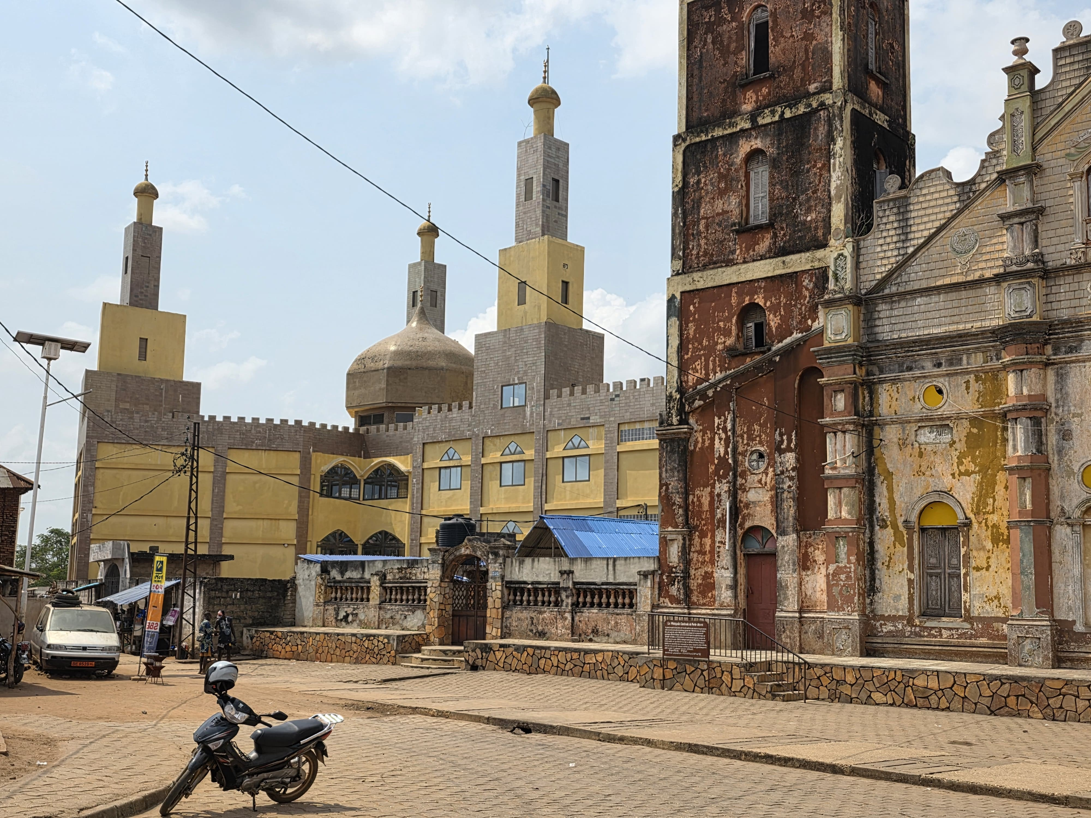
Benin Sacred Journey

Slide 3
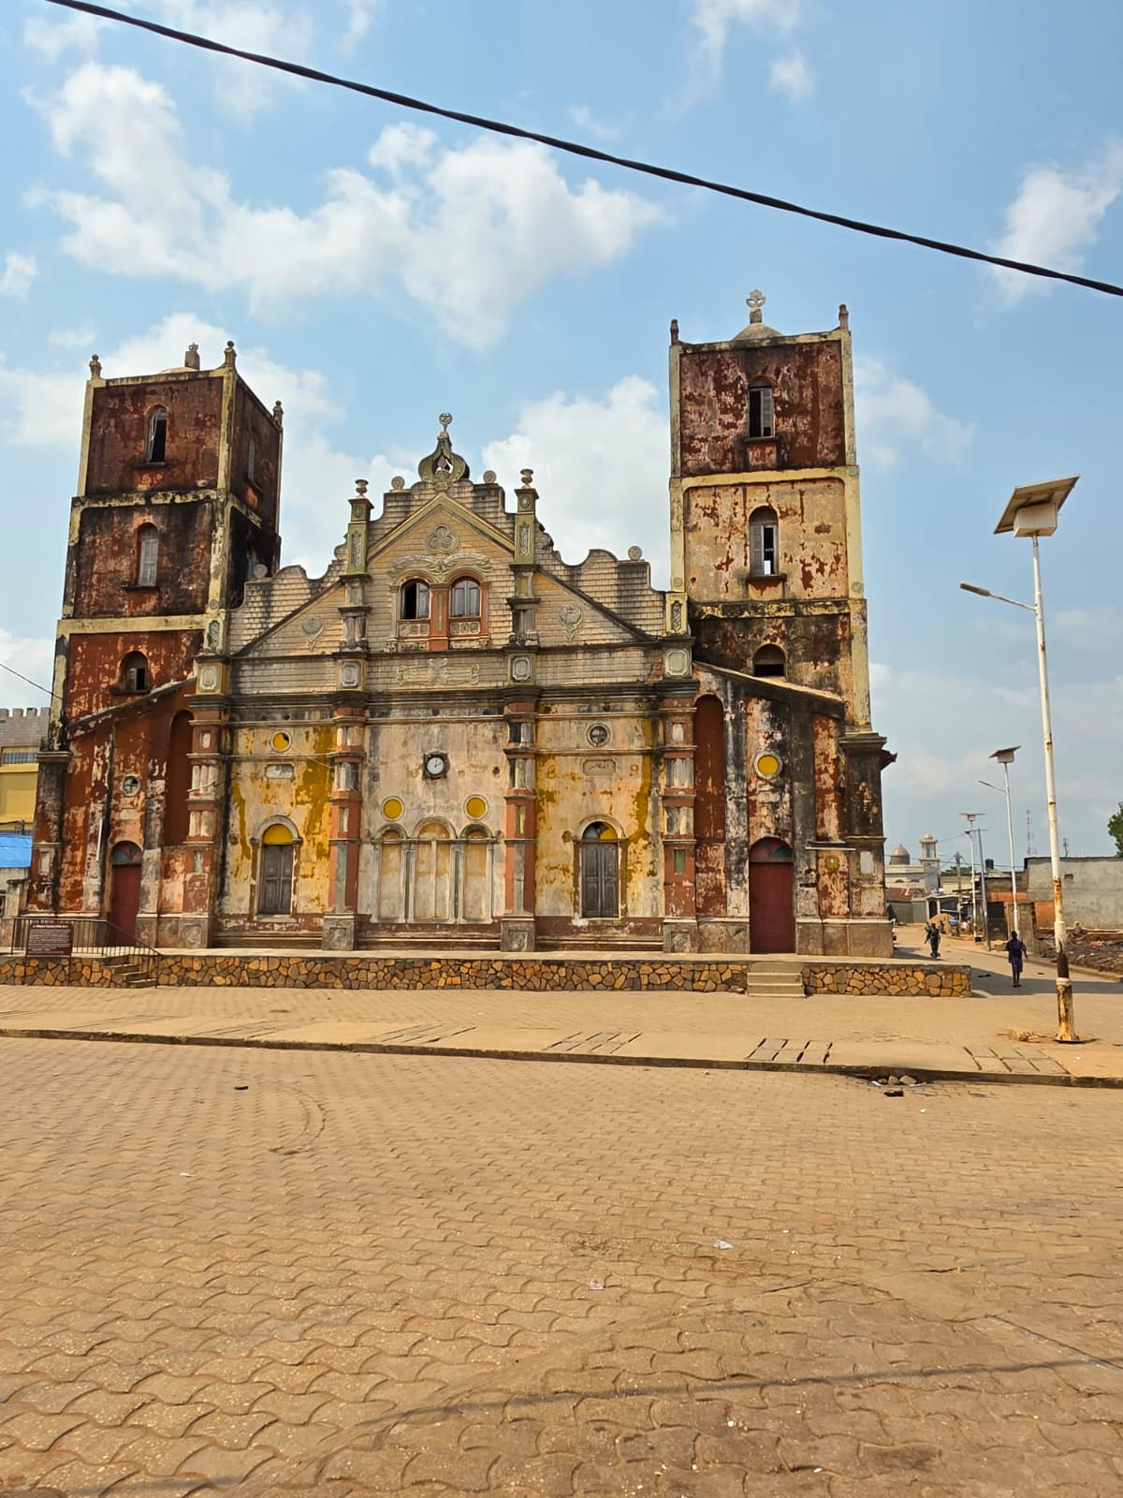
Benin Sacred Journey

Slide 4
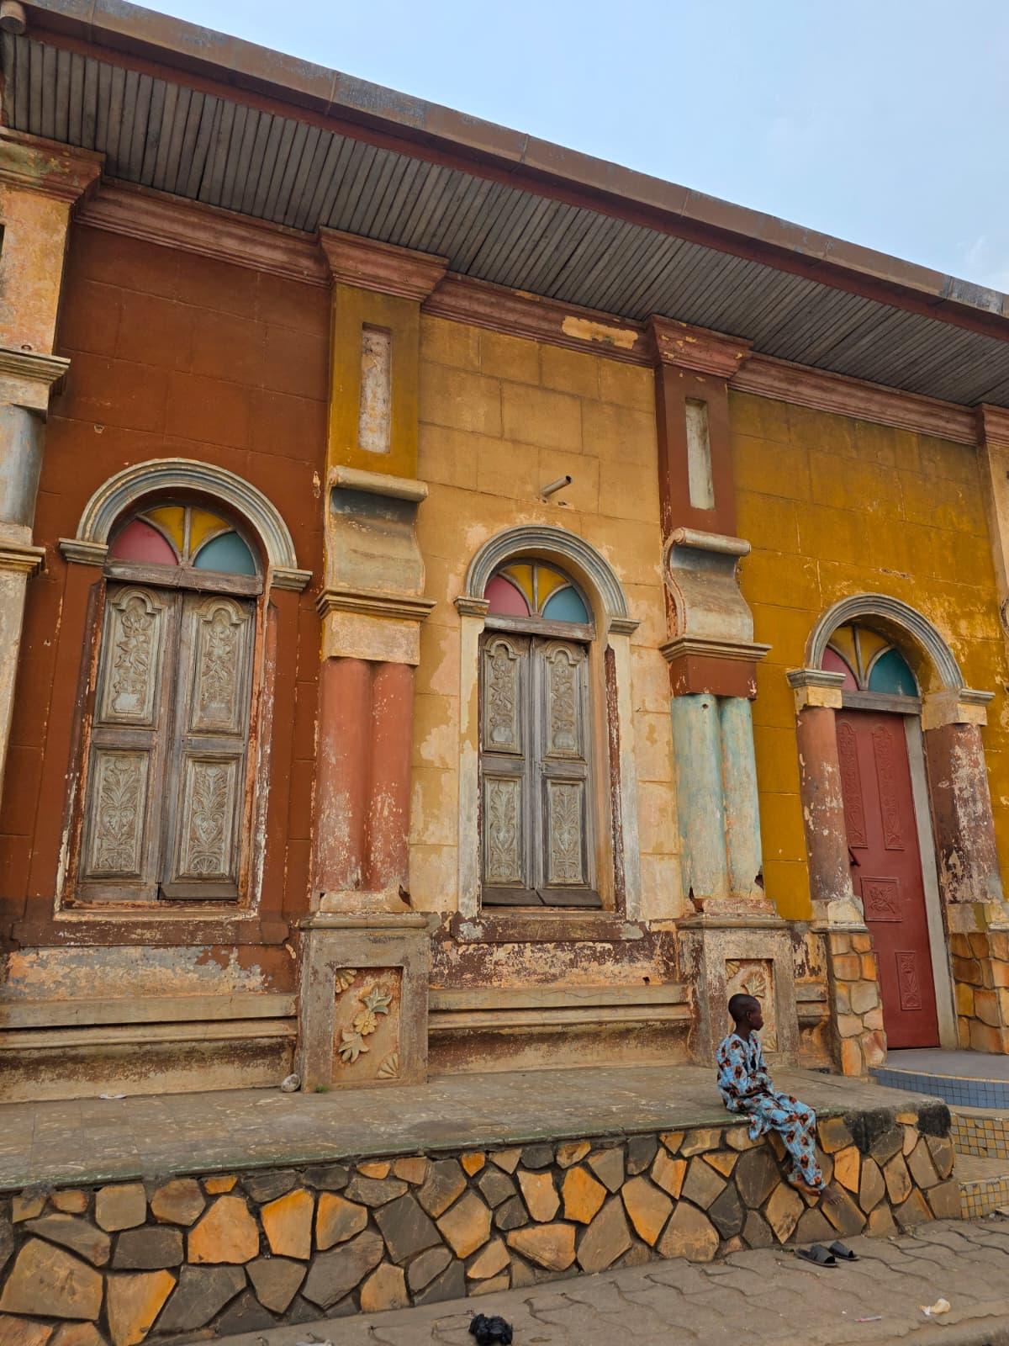
Benin Sacred Journey

Slide 5
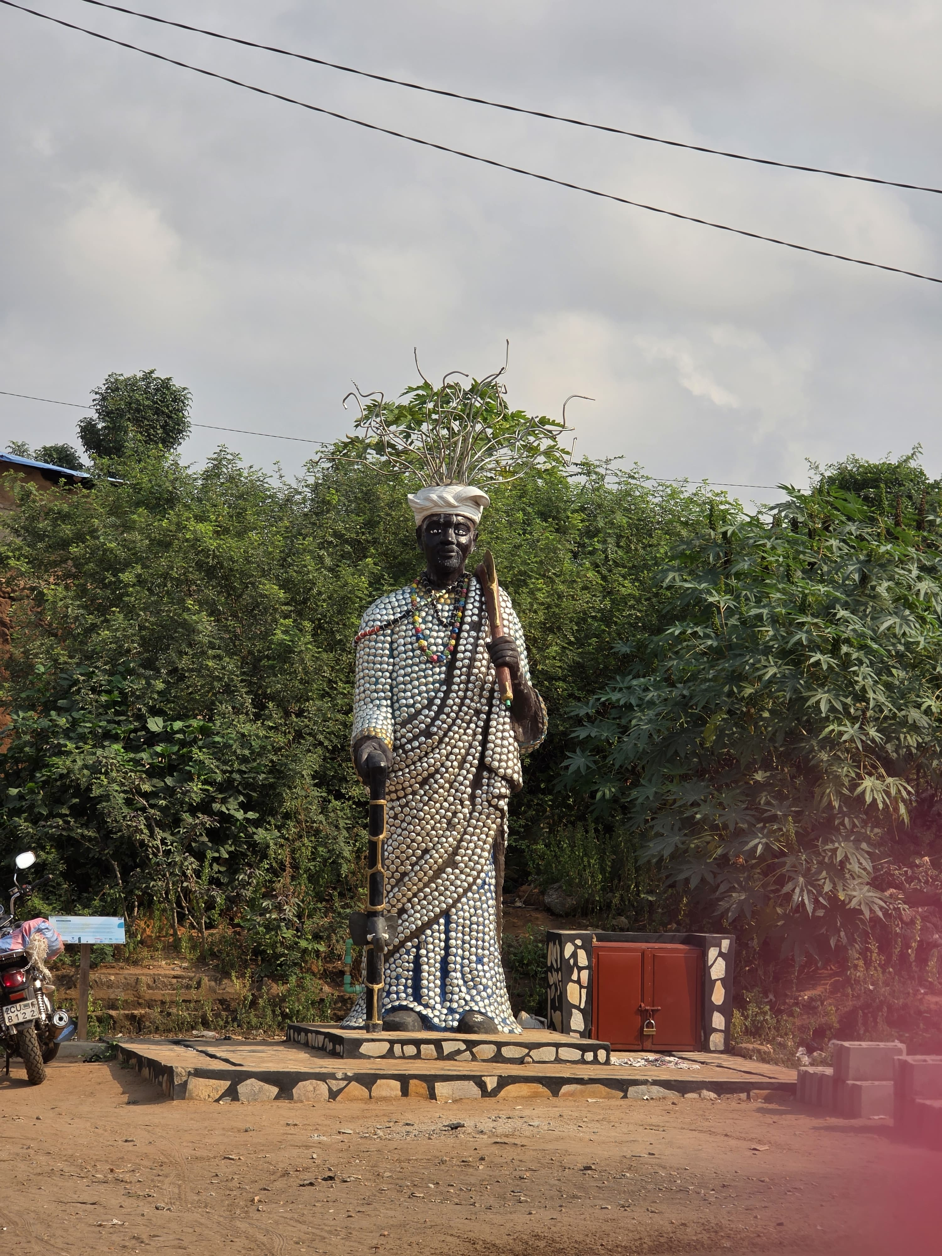
Benin Sacred Journey

Slide 6
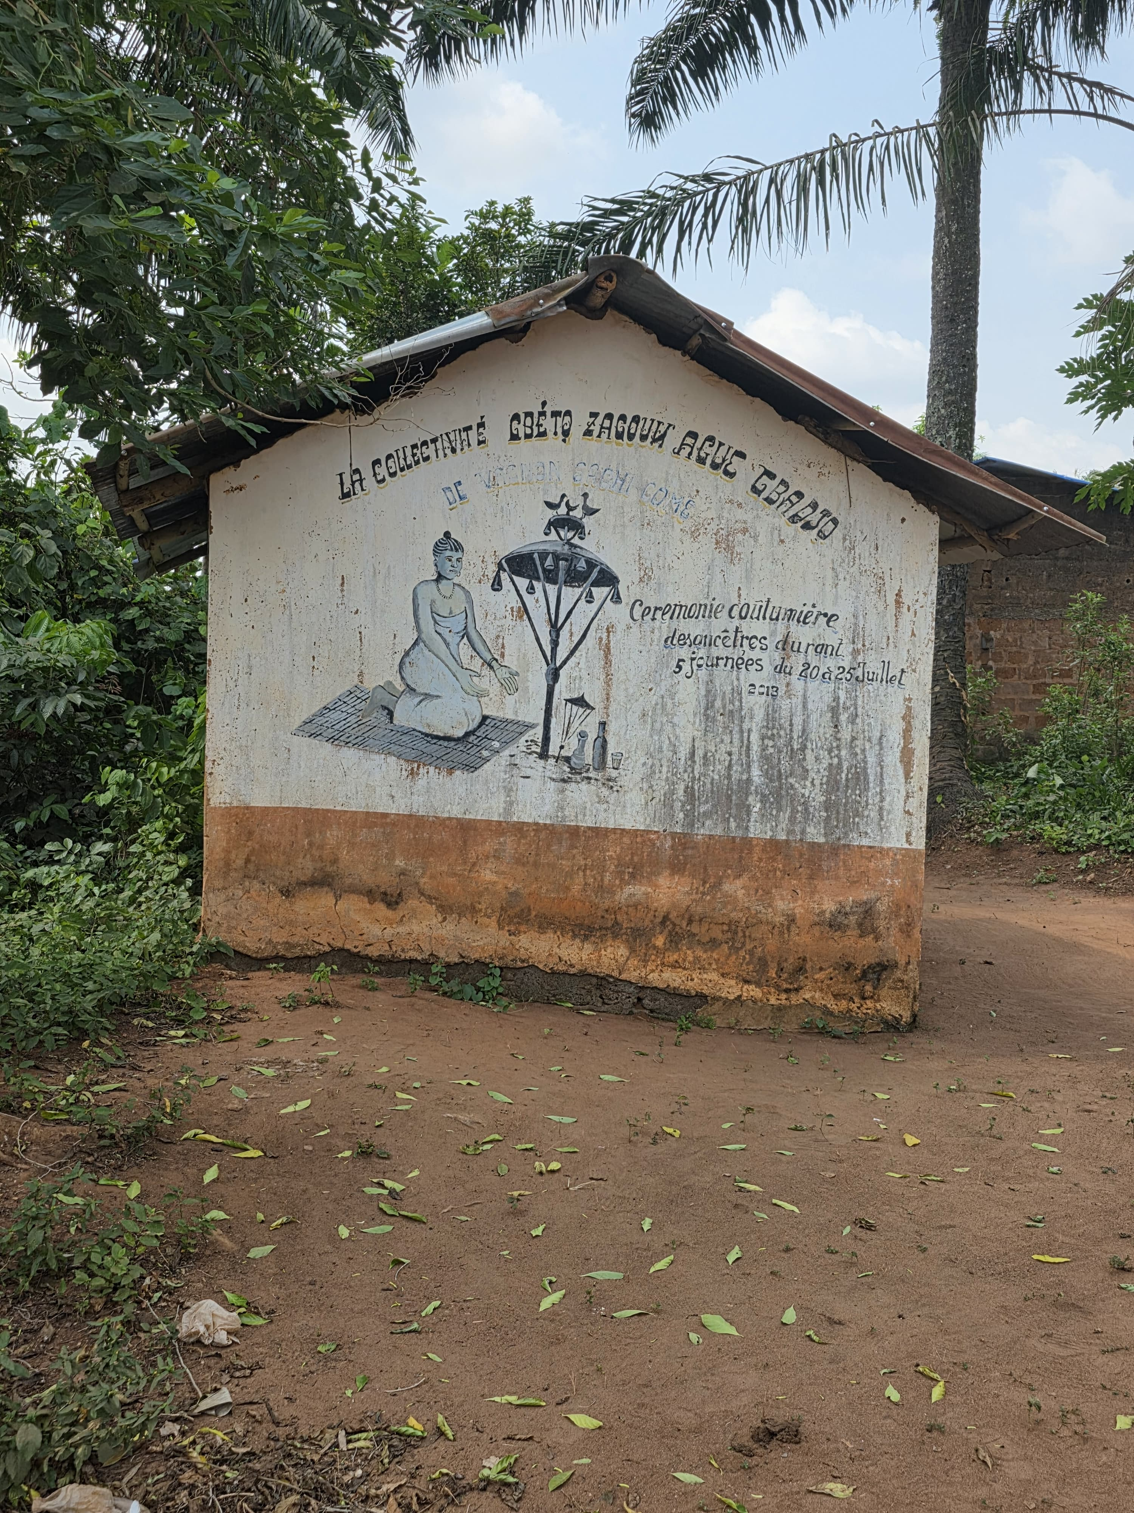
Benin Sacred Journey

Slide 7
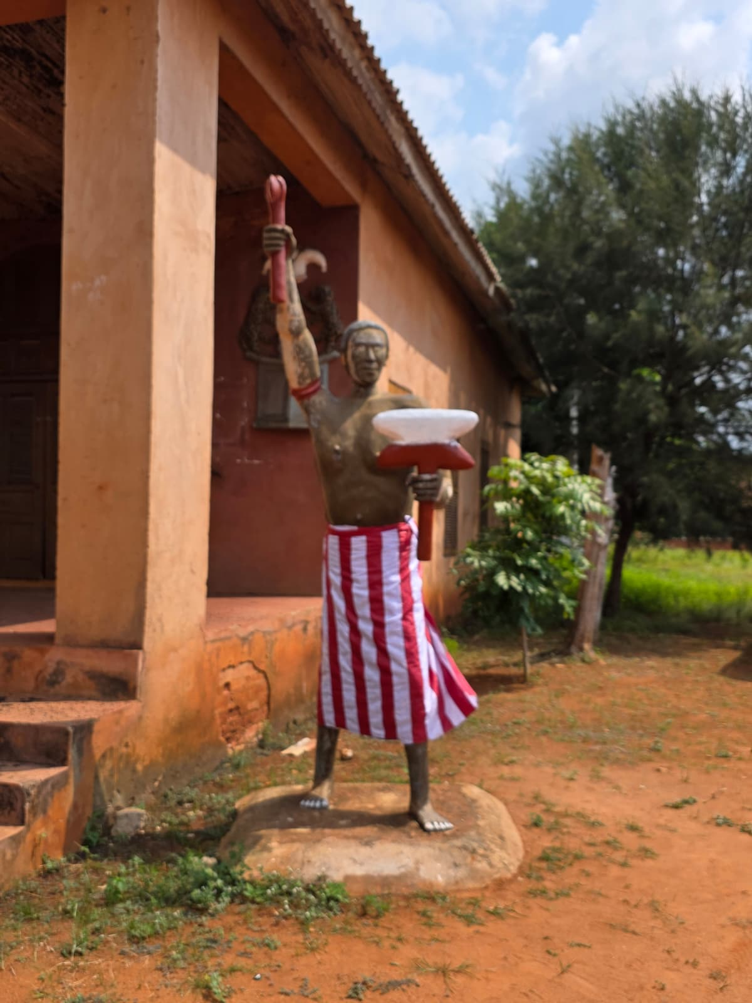
Benin Sacred Journey

Slide 8
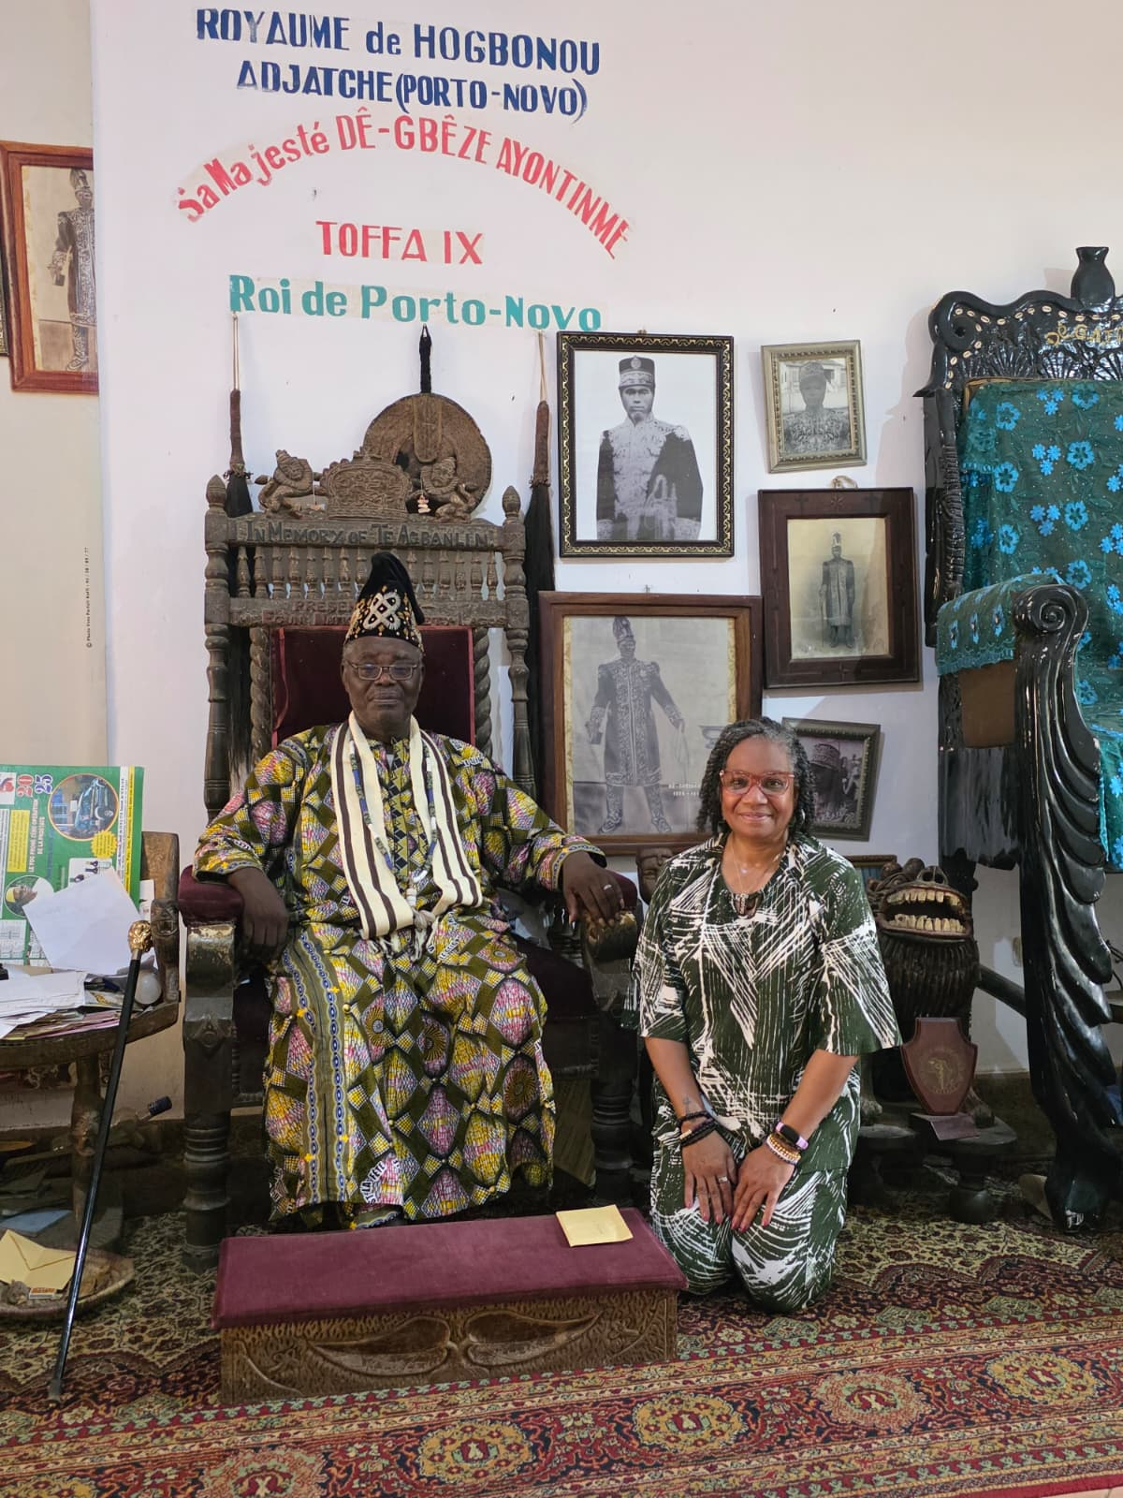
Benin Sacred Journey

Slide 9
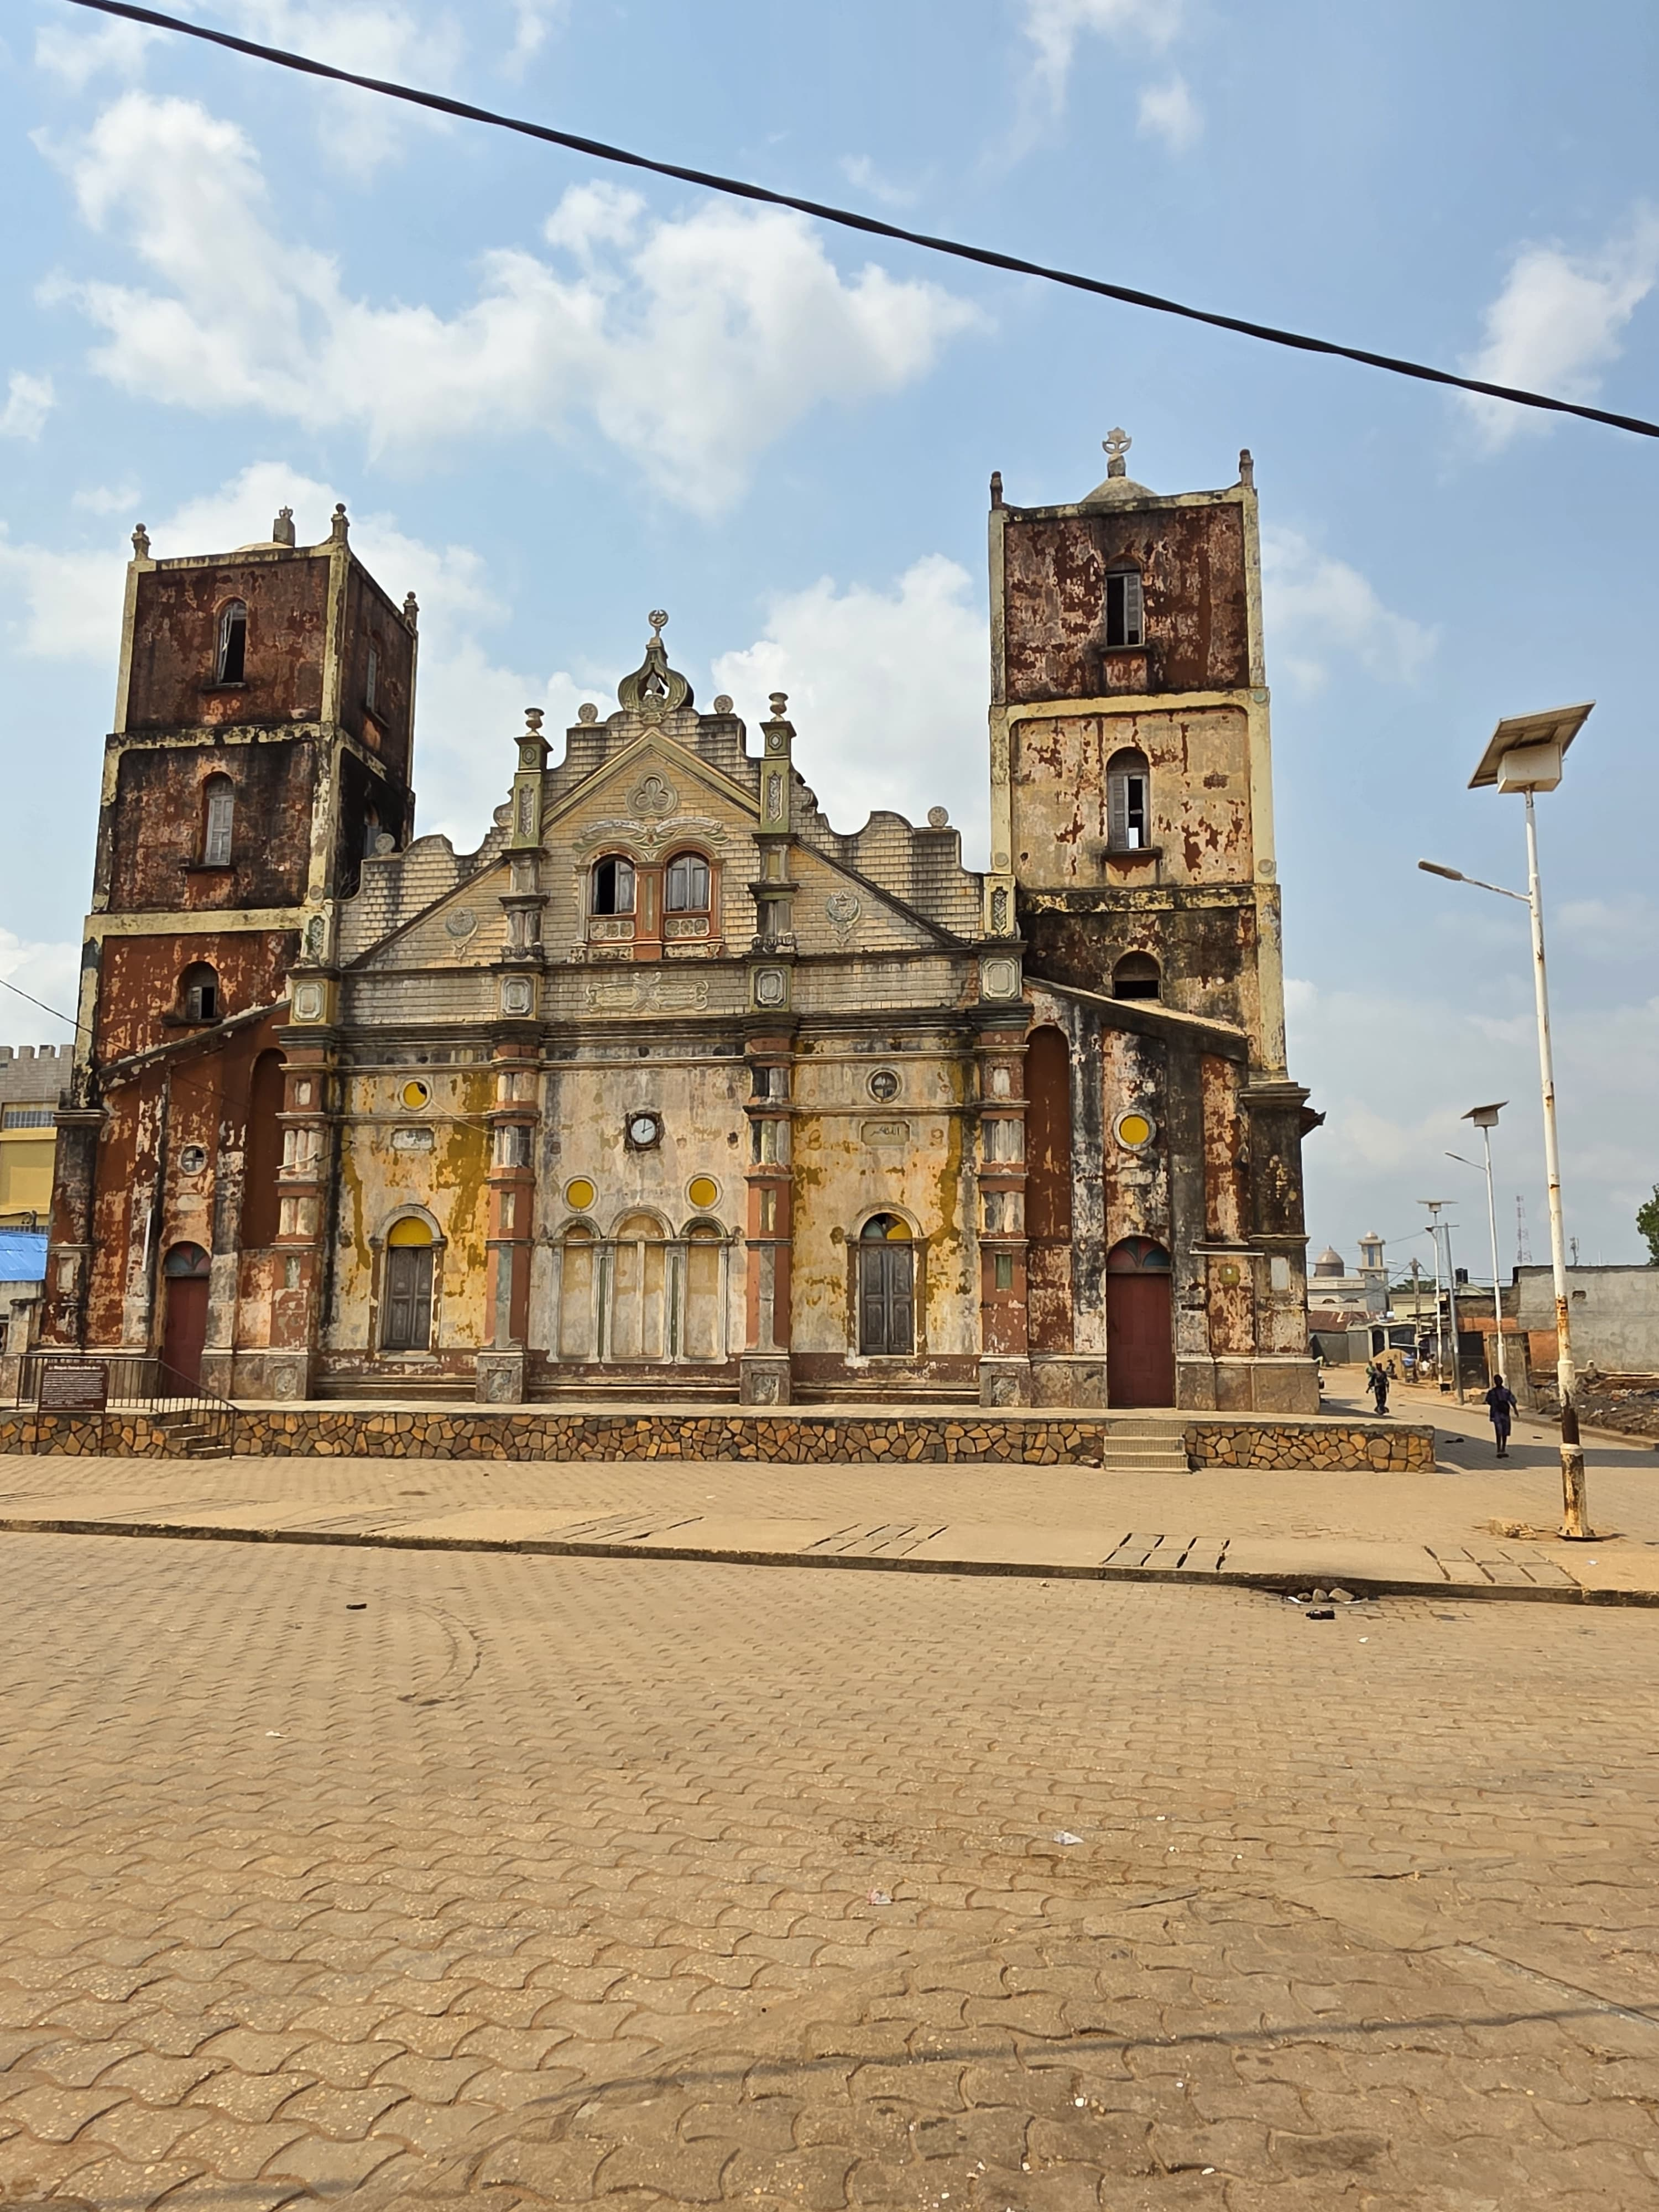
Benin Sacred Journey

Slide 10
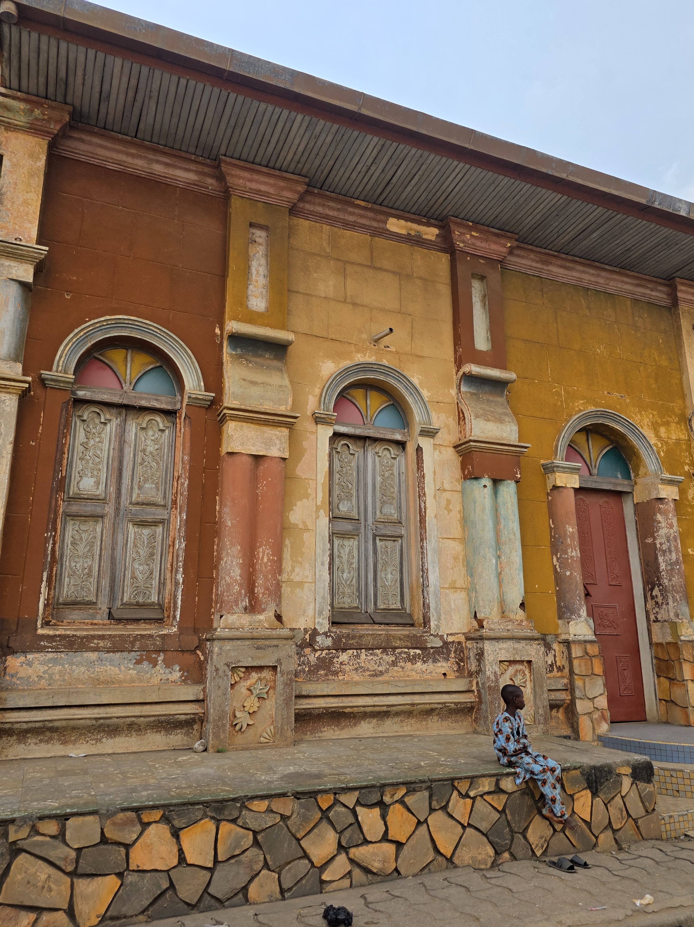
Benin Sacred Journey

Slide 11
Benin Sacred Journey

Slide 12
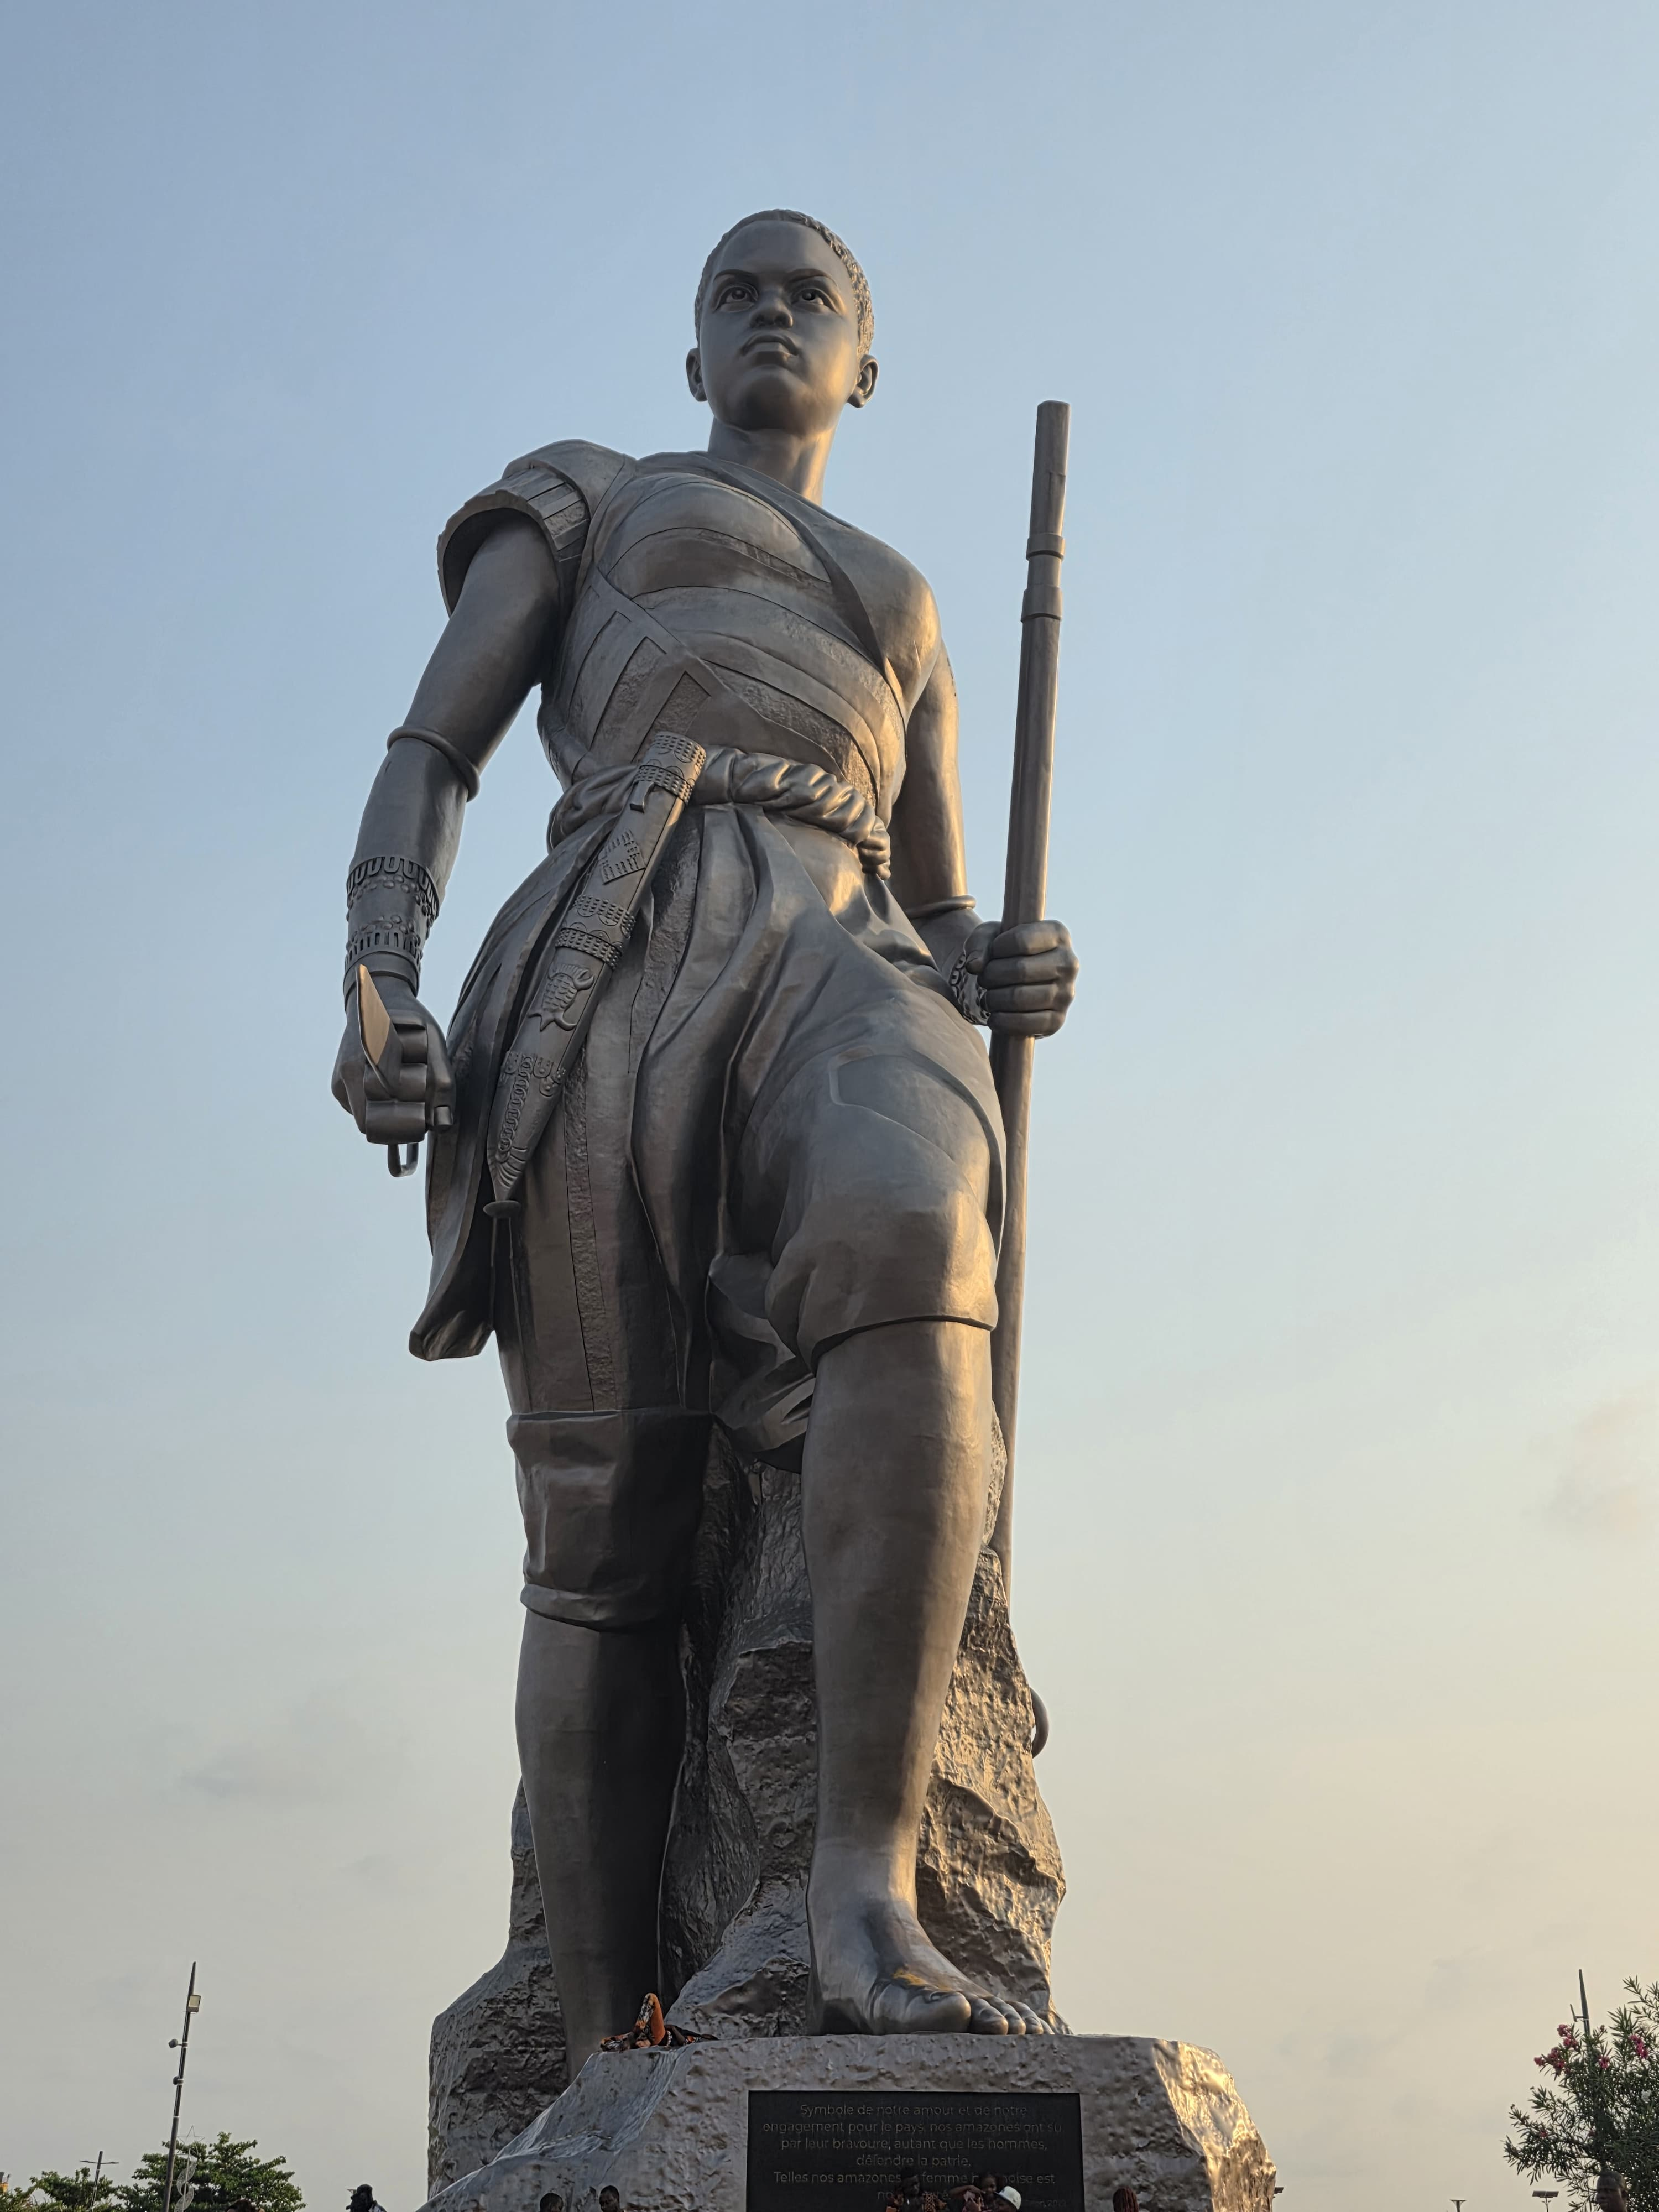
Benin Sacred Journey

Slide 13
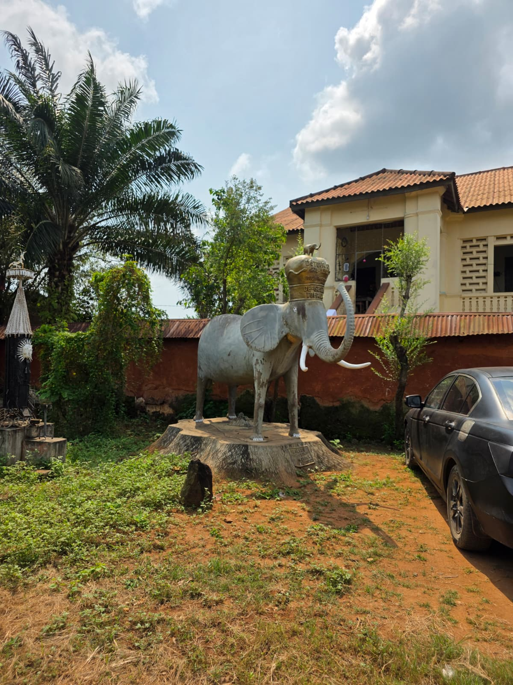
Benin Sacred Journey

Slide 14
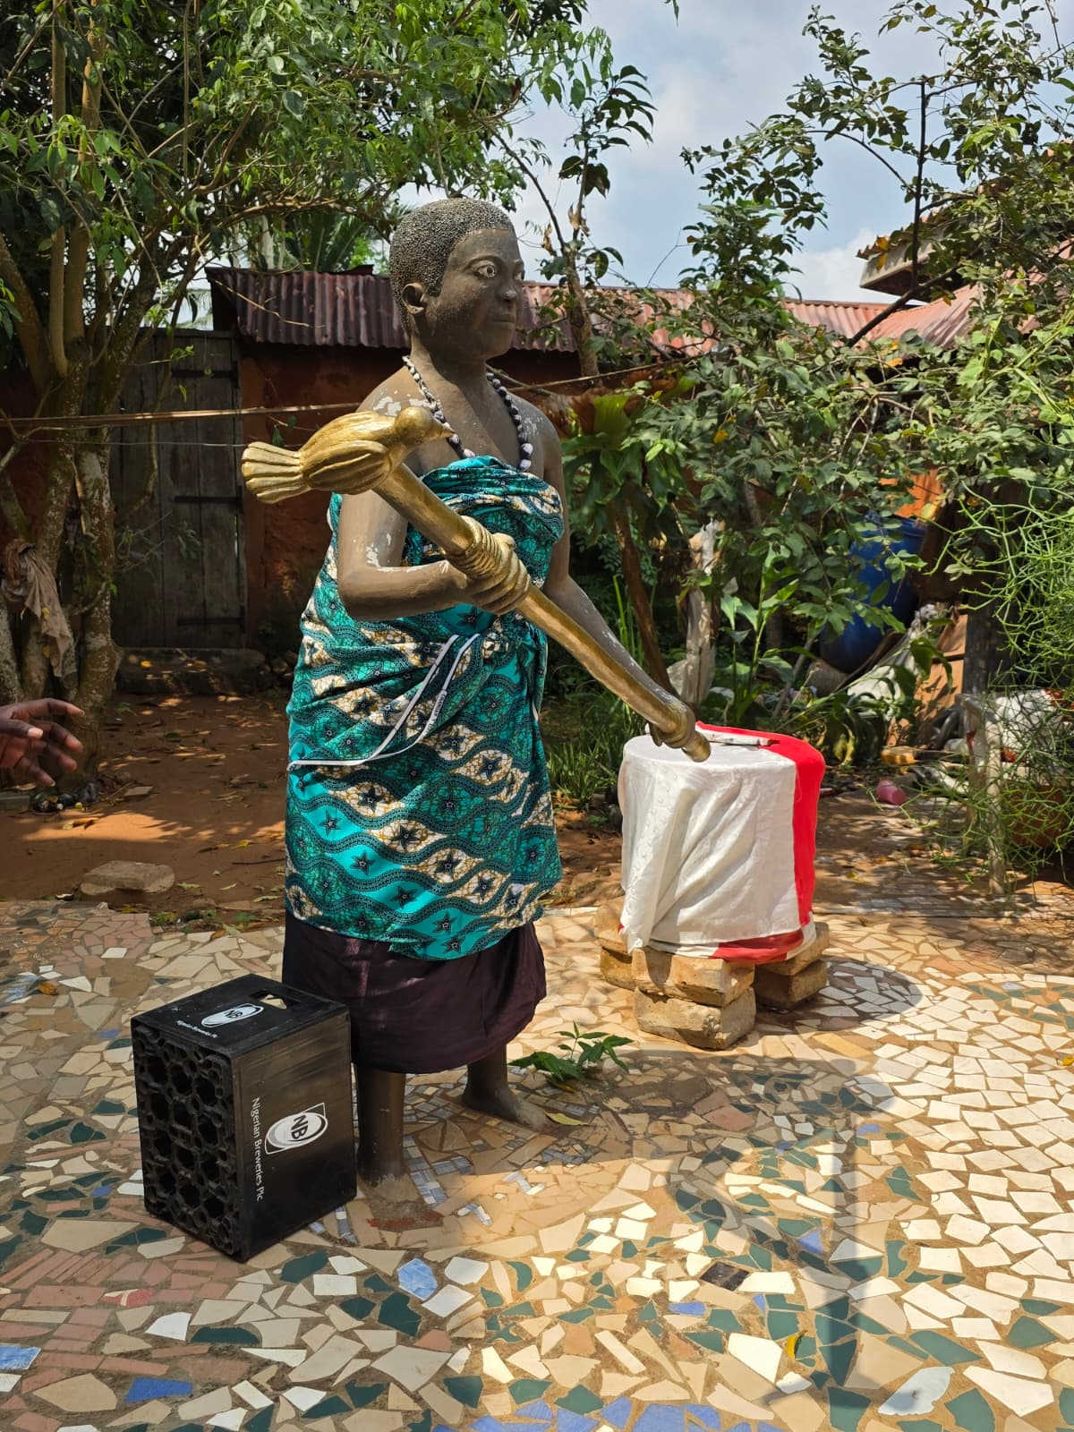
Benin Sacred Journey

Slide 15
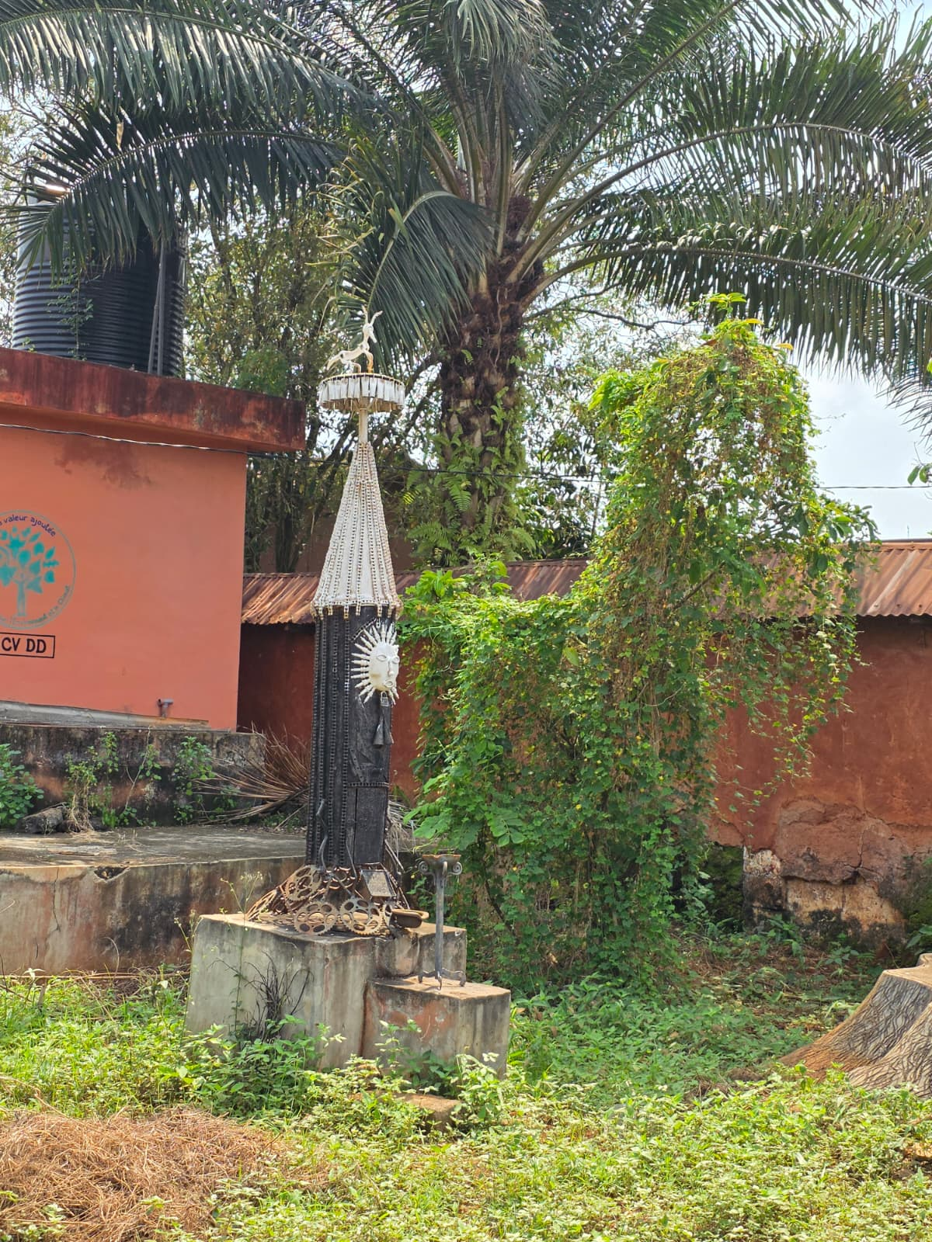
Benin Sacred Journey

